Slide 1
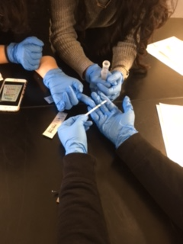
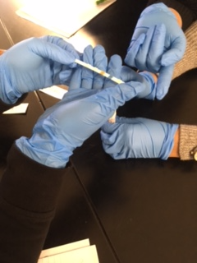
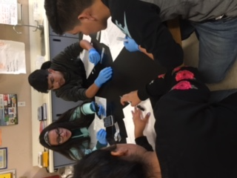
Learning Water Labs
Introducing students in high school to data analysis and water quality

Slide 2
Learning Water Labs
Learning Water Labs: A Collaboration Between Experts in Commercial Farming,
Experts from Community College in Agriculture and Food Safety Science, and
Future Food Safety Scientists
Career Skills and Constructing Knowledge in Authentic Contexts
-practice safe field and laboratory procedures
-procedures that are done with integrity to produce accurate and reliable results
-perform correct hands-on field data collection techniques
-graph data (analyze and present data)
-evaluate self produced and resource supplied graphs
-communicate conclusions based on evidence

Slide 3
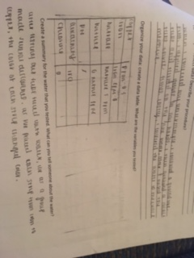
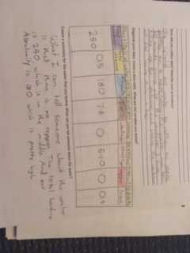
Learning By Doing: Data Analysis Practice
Critical Thinking: Evaluate water collection and analysis
Quantitative Reasoning: Determine the significance of water measurement
Information Literacy: Research the current requirements on a commercial farm
Written Communication: Describe functional requirements of a treatment processes.

Slide 4
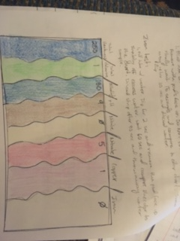
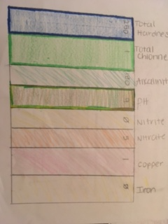
Learning By Doing: Data Analysis Practice
HS-ESS2-5 Plan and conduct an investigation of the properties of water and
its effects on Earth materials and surface processes.

Slide 5
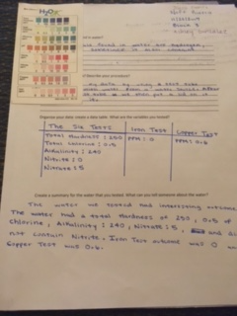
Learning By Doing: Data Analysis Practice
Science and Engineering Practices
-Developing and Using Models
-Using Mathematics and
Computational Thinking
-Constructing Explanations and
Designing Solutions
-Engaging in Argument from Evidence
Cross-Cutting Concepts
Cause and Effect
Scale, Proportion, and Quantity
Systems and System Models
Energy and Matter
Stability and Change

