Slide 1
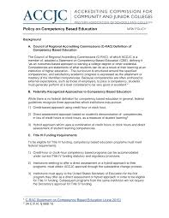
Clint Cowden
Direct Assessment Competency-Based Education Collaborative
Dean | Academic Affairs
2/9/21

Slide 2
Collaborative Overview and Objectives

Slide 4
BUDGET ALLOCATION AND MILESTONE PAYMENT PROCESS

Slide 5
First Steps

Slide 6
First Steps

Slide 7
The Ask
Gather a group of interested participants
Member from each Metamajor Area
Student Services
Institutional research
IT
Financial aid
HCFA
Complete the application by Feb 5th

Slide 9
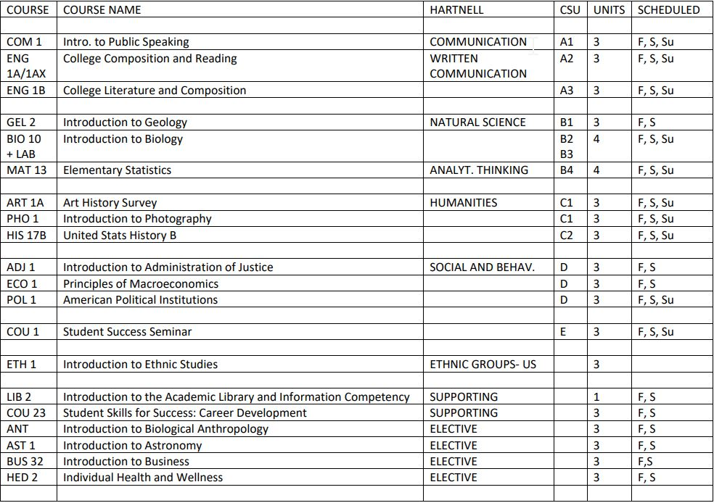
POSSIBLE 2 YEAR, FULLY ONLINE ASSOCIATES IN LIBERAL ARTS, cbe

Slide 10
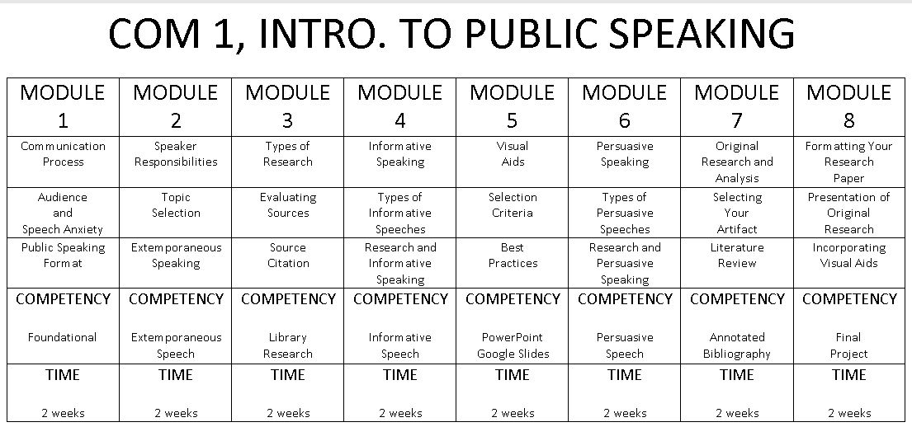
CBE SAMPLE COURSE

Slide 11
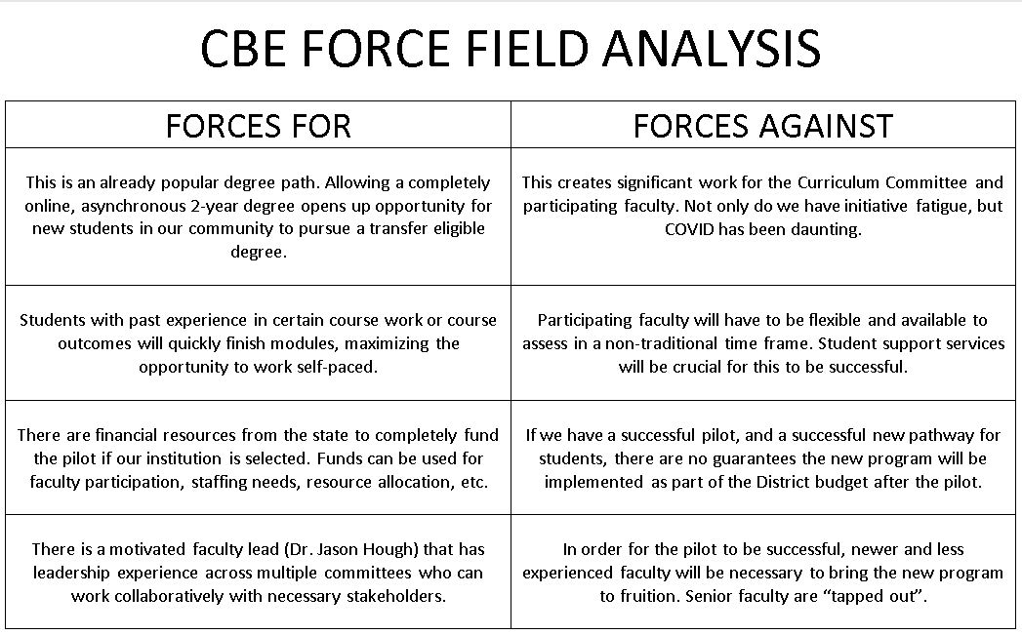

Slide 12
Questions

Slide 13
Links
ACCJC
Policy on Competency Based Education
Grant
Direct Assessment Competency-Based Education Collaborative
DQP
National Institute for Learning Outcomes Assessment
CBE Grant Open Question Hour
Zoom Link (1/15/31 @ 11 AM)

