Slide 1
Dr. Jason Hough
Faculty Return to Work Survey
Sponsored by the Hartnell Academic Senate
Sponsored by the Hartnell College Faculty Association
02/22/21

Slide 2
RATIONALE
The State of California announced recently that all educators would be eligible for the COVID-19 vaccine beginning March 3.
The same week, Governor Newsom announced 10 percent of all incoming vaccine shipments would be set aside for educators.
As of today, vaccine eligibility for educators has been accelerated in neighboring counties to begin March 1, with the assumption Monterey County will follow.

Slide 3
The Survey
Sent to all full-time and part-time faculty members.
The survey consisted of basic demographic data, as well as Likert-scale, multiple choice and short answer questions.
The survey was created in Google Forms and distributed via email on 02/18/21 and was closed at noon on 02/22/21.

Slide 4
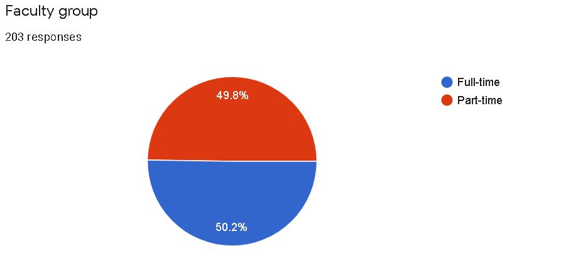
respondents
There were 203 faculty respondents to the survey.
Of these, 102 were full-time and 101 were part-time. Respondents represented the majority of disciplines at Hartnell College.

Slide 5
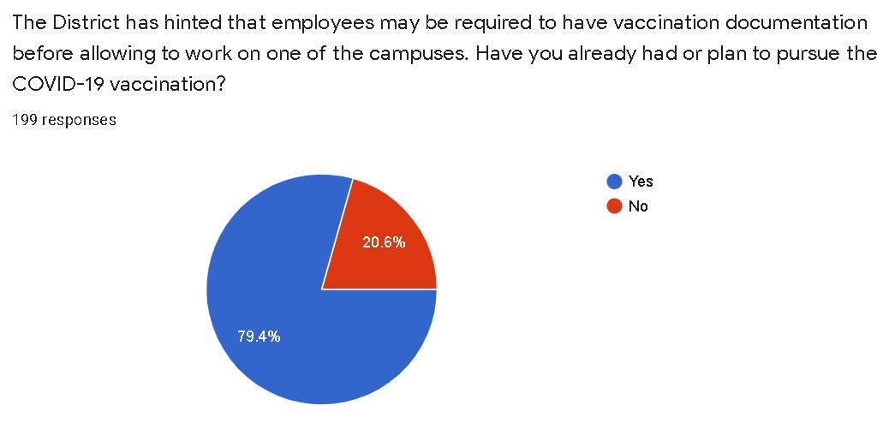
QUESTION 1
Slightly over 20 percent of faculty indicated they have not/will not receive the vaccine.
158 faculty members indicated “yes”, 41 “no”, and four left it blank.
Of the 41 answering “no”, 18 were full-time faculty.

Slide 6
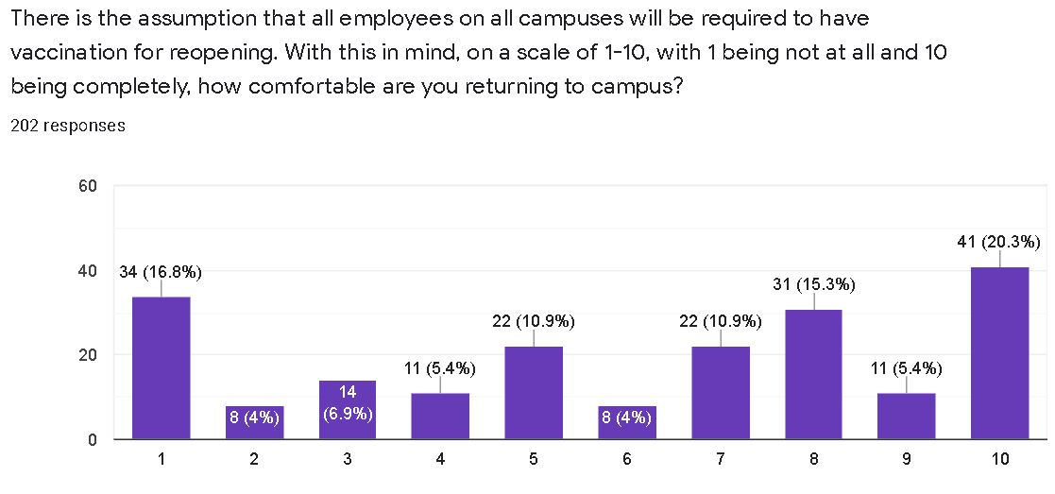
QUESTION 2
The majority (55.9 percent) answered above the mid-point.
However, in terms of comfort, a significant percentage (44 percent) of faculty indicated mid-point or below.

Slide 7
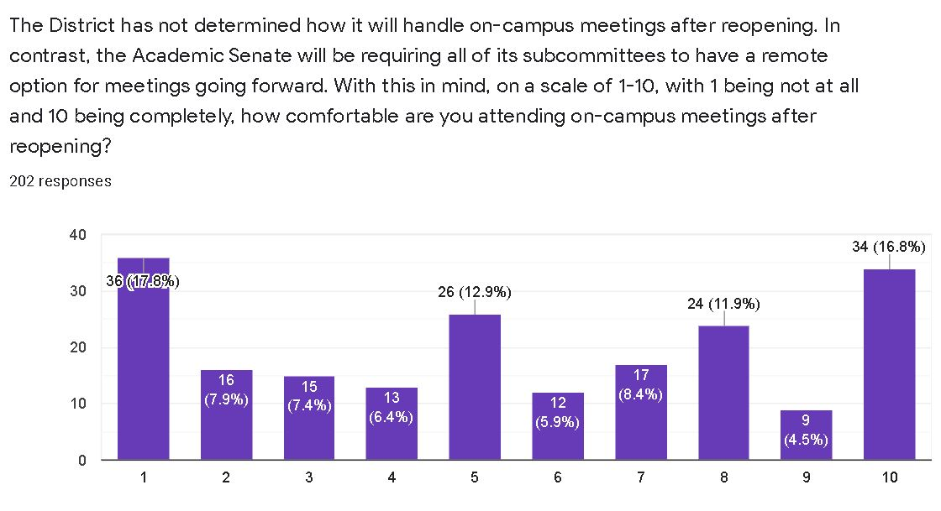
Question 3
Fewer faculty were above the mid-point, with only 47.5 percent.
The majority were mid-point or below, with a full one-third of the faculty (33.1 percent) selecting the lowest three rankings.

Slide 8
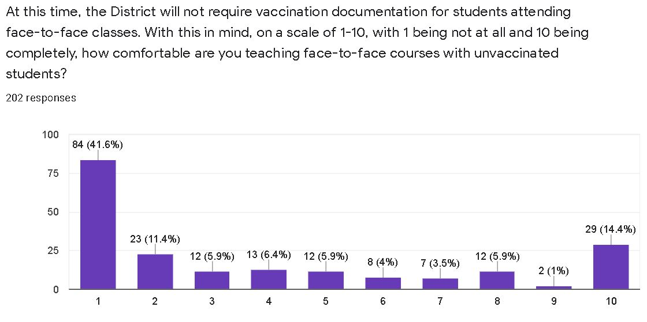
Question 4
71.2 percent of faculty answered mid-point or below.
A full 41.6 percent selected the lowest ranking possible.

Slide 9
QUESTION 5
146 faculty responded
The complete list of concerns is available for perusal.
Three main areas of concern were consistent:
Vaccination mandate and timing or reopening
Safety protocols and enforcement
Fear of contracting COVID-19 from unvaccinated students and carrying it to unvaccinated family members

Slide 10
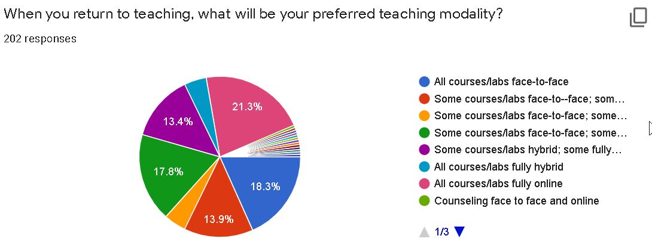
Question 6
21.3 percent prefer fully online
18.3%percent prefer fully ftf
17.8 percent prefer some ftf/hybrid/fully online
13.9 percent prefer some ftf/hybrid
13.4 percent prefer some hybrid/fully online

Slide 11
takeaways
Reopening will not be a switch. Only a phased approach with the most willing faculty members for face-to-face classes will provide the smoothest transition. The District needs to find out now which of the faculty are ready to come back face-to-face in the first “wave”.
1/5 of the faculty will not be pursuing the vaccine. Some of these are for currently recognized legal reasons; others are not. How will the District address these with its right of assignment?
The vast majority of faculty are not comfortable returning to campus with unvaccinated students. Forcing an en masse return of faculty all at once would not be advisable and would produce attitudinal barriers.

Slide 12
Takeaways (conT’d)
Hybrid and online modalities will have a significant increase in demand from faculty. There will also be an increased demand from the student body.
With this reality, part of the reopening plan from the District should include reconsidering allocation of resources. For example, more hybrid and online education means less space for physical classes/more space for technology and learning support.
The “new normal” at Hartnell College will not be the same as pre-pandemic… nor should that be a goal. All stakeholders need to acknowledge the lasting fundamental shifts the pandemic has made not only for our institution, but broader society. This reality should be discussed in negotiations:
Allowing some faculty and staff to remain 100 percent remote
New benefits, such as Internet and/or cellular phone stipends
All meetings having a remote option going forward

Slide 13
Questions?

