Slide 1
Presentation to Administrative Services Council
Hartnell College Office of Advancement
Jackie Cruz, Vice President of Advancement
Michele Peregrin, Director of Grants Development
Thursday, June 25, 2020

Slide 2
Advancement Council Read-Out
Advancement Council met on May 21 and expressed the below regarding proposed budget revisions:
Dissent for cutting a week of administrators' vacation.
Support for pursuing CARES Act funding for HSIs.
Support for partnering with external organizations to leverage resources.
Support for pursuing more grants as a way to increase revenue.
Support for attracting various student types, e.g. adult learners, to increase revenue.
Tentative support for increasing industry partnerships and contract education to increase revenue (the tentativeness is due to limited bandwidth).
Support for increasing marketing regarding online opportunities to prospective students.
Support for examining course efficiency and potential savings from the 16-week calendar as a way to cut costs.
Support for establishing more apprenticeship programs as a way to increase revenue.
Support for developing a report about the Matsui land.

Slide 3
Better Careers- A New Initiative
Objective: Create a new job placement system at the college that is aligned with the college strategic plan and redesign.
Core elements:
A central system of coordination for work-based learning and direct student services, from career readiness to direct placement;
Dedicated personnel with sector specific knowledge and employer relationships, who act as connectors to work-related opportunities;
An expanded selection of work experience opportunities, including those embedded in CTE programs and others, such as formal apprenticeships; and
A cohort model for delivering social and academic support aligned with college redesign meta majors plan

Slide 4
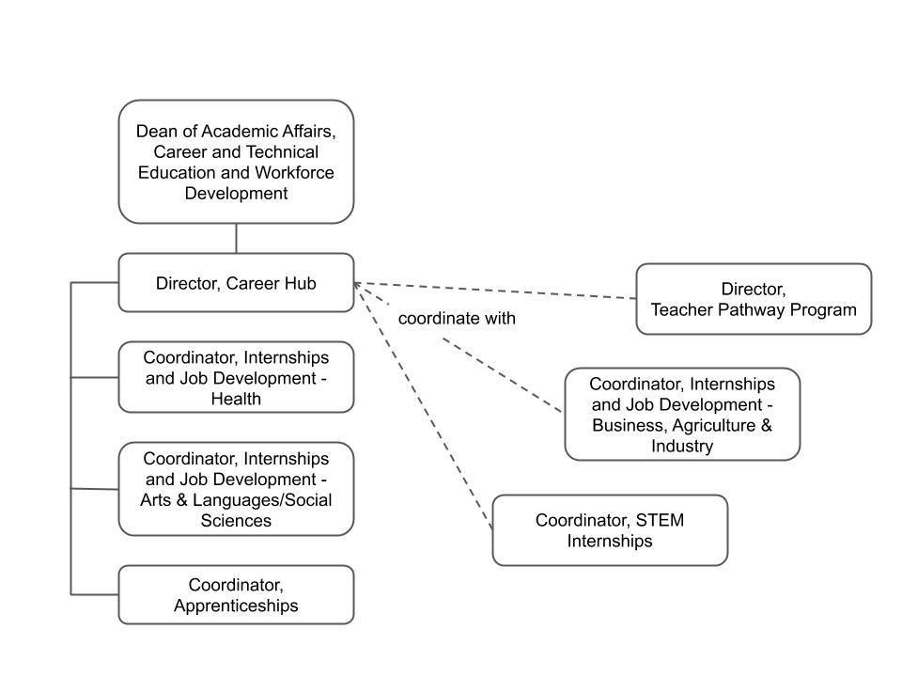
Better Careers- A New Initiative
Prioritized for funding

Slide 5
Better Careers- A New Initiative
AB1809 Incentives colleges to use formalized apprenticeship programs to support students. The new method allows to capture the full FTEs reimbursement amount instead of the per credit hour formula.
Expected Outcomes
Establish 3 to 5 new apprenticeship programs within 3 years, which will result in a minimum of 160 participants successfully completing and securing employment that pays at least $18 per hour.
Conservative projection: 60 current students plus 100 news student (20 per apprenticeship)=> approx. 43 FTES = approx. $200,000
Ideal Projection: 60 students plus 300 new students (60 per apprenticeship)=> approx. 98 FTES = approx. $475,000
Results
Hartnell will be a regional leader in preparing community members for high-quality jobs.
The workforce development needs of diverse employers will be addressed by incorporating robust employer engagement, buy in and investment in the newly created career placement hub at Hartnell College.

