Slide 1
The Grille’s Food Cost
FOOD COST DEFINITION
Food Cost is defined as the percentage of total sales spent on food products in a food service area.
The average restaurant’s food cost is 28-35%.
Ideal food cost is 20%
The average food cost at The Grille is 61%
Our highest food cost is 115%
Even after applying these proposed increases we will average a 42% food cost, which is still high.
In addition to the food cost concern, we have labor & other overhead to cover.

Slide 2
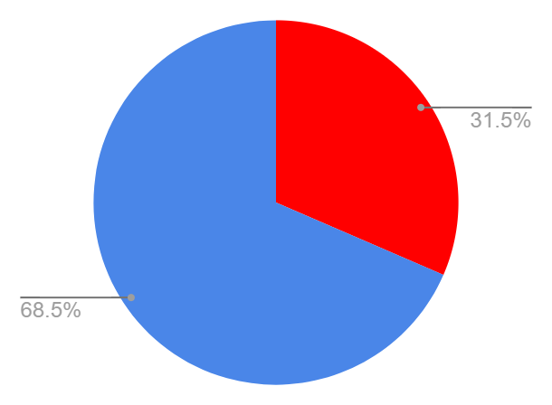
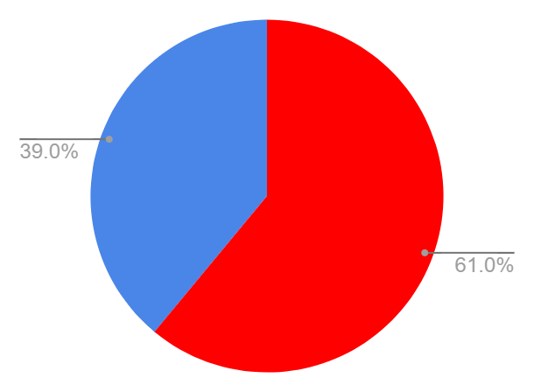
Average Food Cost vs. The Grille Food Cost
Average Food Cost (28-35%)
Food Cost
Remaining Percentage after covering food cost, to cover additional overhead
The Grille’s Food Cost (61%)
Remaining Percentage after covering food cost, to cover additional overhead
Food Cost

Slide 3
The Grille’s Labor & Other Overhead
Employees:
Food Service Manager
Part-time Assistant (CSEA)- vacant due to budget restrictions
Lead Food Service Worker, 11-month (L-39)
Food Service Worker, 10-month (L-39)
Food Service Worker, 10-month (L-39)
Part-time Food Service Worker, 9-month (L-39)
Student Workers (1-5 depending on demand)
Equipment, Equipment Maintenance, & Cloud Storage contracts
Credit card processing fees (processing fee, interchange fee, assessment fee)
Linen & Cleaning Supplies
Water & Coffee Systems
Food & Beverage Components
Delivery Fees

Slide 4
Potential Food Cost
Potential Food Cost is a theoretical or ideal percentage that indicates what the food cost should be in a perfectly run food service area.
In order to achieve our potential food cost, we must raise the prices of our handmade food by at least 70% while also increasing business.
Our goal is to only have to increase prices by 60% and make up the additional 10% with catering.

Slide 5
Actual Cost of Food at Local Campuses
ITEM | HARTNELL | MPC | GAVILAN | Hartnell to MPC % change | Hartnell to Gavilan % change
Hamburger | 3.5 | 8 | 6.29 | 128.57% | 79.71%
Cheeseburger | 4 | 9 | 7.69 | 125.00% | 92.25%
Chicken Sandwich | 3.75 | 10.5 | 7.49 | 180.00% | 99.73%
Turkey Club | 5.5 | 11 | 9.89 | 100.00% | 79.82%
Tuna Sandwich | 4.75 | 10.5 | 8.89 | 121.05% | 87.16%
Grilled Cheese | 3.25 | 7 | 5.99 | 115.38% | 84.31%
Quesadilla | 3.5 | 5 | 5.95 | 42.86% | 70.00%
Chicken Tenders | 3.5 | 7.5 | 6.29 | 114.29% | 79.71%
Burrito | 6 | 10.5 | 10.29 | 75.00% | 71.50%
Breakfast Burrito | 5.5 | 8 | 8.49 | 45.45% | 54.36%
Parfait | 2.75 | 6 | 5.79 | 118.18% | 110.55%
Breakfast Sandwich | 3.75 | 7 | 6.89 | 86.67% | 83.73%
Turkey Sandwich | 4.75 | 9 | 8.89 | 89.47% | 87.16%
Chicken Caesar Salad | 5.5 | 10 | 10.29 | 81.82% | 87.09%
Green Salad | 3.75 | 9 | 6.99 | 140.00% | 86.40%
Average Item = | 4.109375 | 8.25 | 7.475 | 103.98% | 83.00%

Slide 6
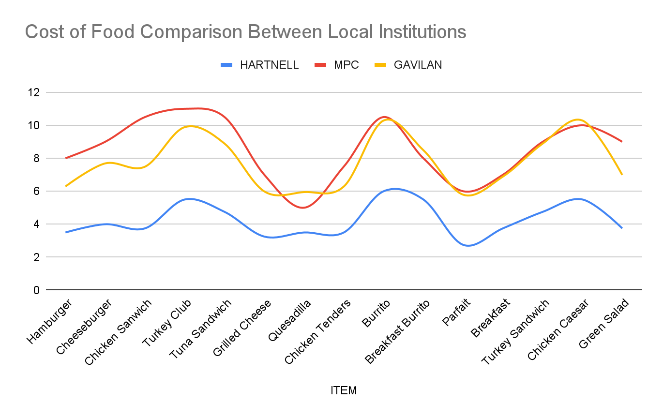
Cost of Food Comparison

Slide 7
Three Phase Application of Increases
.
ITEM | Current Pricing | Spring FY24 | Fall FY25 | Spring FY25
Hamburger | 3.5 | 4.20 | 4.90 | 5.6
Cheeseburger | 4 | 4.80 | 5.60 | 6.4
Chicken Sandwich | 3.75 | 4.50 | 5.25 | 6
Turkey Club | 5.5 | 6.60 | 7.70 | 8.8
Tuna Sandwich | 4.75 | 6.10 | 7.45 | 8.8
Grilled Cheese | 3.25 | 3.90 | 4.55 | 5.2
Quesadilla | 3.5 | 4.00 | 4.50 | 5
Chicken Tenders | 3.5 | 4.20 | 4.90 | 5.6
Burrito | 6 | 7.20 | 8.40 | 9.6
Fries | 2 | 2.43 | 2.87 | 3.3
Breakfast Burrito | 5.5 | 6.33 | 7.17 | 8
Parfait | 2.75 | 3.30 | 3.85 | 4.4
Breakfast Sandwich | 3.75 | 4.50 | 5.25 | 6
Turkey Sandwich | 4.75 | 5.70 | 6.65 | 7.6
Chicken Caesar Salad | 5.5 | 6.60 | 7.70 | 8.8
Green Salad | 3.75 | 4.50 | 5.25 | 6
Average Item = | 4.109375 | 4.929166667 | 5.748958333 | 6.56875

Slide 8
Proposed Pricing Compared to Local Institutions
ITEM | Hartnell Proposed Prices | MPC | GAVILAN | Hartnell to MPC %Change | Hartnell to Gavilan %Change
Hamburger | 5.6 | 8 | 6.29 | 42.86% | 12.32%
Cheeseburger | 6.4 | 9 | 7.69 | 40.63% | 20.16%
Chicken Sandwich | 6 | 10.5 | 7.49 | 75.00% | 24.83%
Turkey Club | 8.8 | 11 | 9.89 | 25.00% | 12.39%
Tuna Sandwich | 8.8 | 10.5 | 8.89 | 19.32% | 1.02%
Grilled Cheese | 5.2 | 7 | 5.99 | 34.62% | 15.19%
Quesadilla | 5 | 5 | 5.95 | 0.00% | 19.00%
Chicken Tenders | 5.6 | 7.5 | 6.29 | 33.93% | 12.32%
Burrito | 9.6 | 10.5 | 10.29 | 9.38% | 7.19%
Fries | 3.3 | 4 | 3.49 | 21.21% | 5.76%
Breakfast Burrito | 8 | 8 | 8.49 | 0.00% | 6.13%
Parfait | 4.4 | 6 | 5.79 | 36.36% | 31.59%
Breakfast Sandwich | 6 | 7 | 6.89 | 16.67% | 14.83%
Turkey Sandwich | 7.6 | 9 | 8.89 | 18.42% | 16.97%
Chicken Caesar Salad | 8.8 | 10 | 10.29 | 13.64% | 16.93%
Green Salad | 6 | 9 | 6.99 | 50.00% | 16.50%
Average Item = | 6.56875 | 8.25 | 7.475 | 27.31% | 14.57%

Slide 9
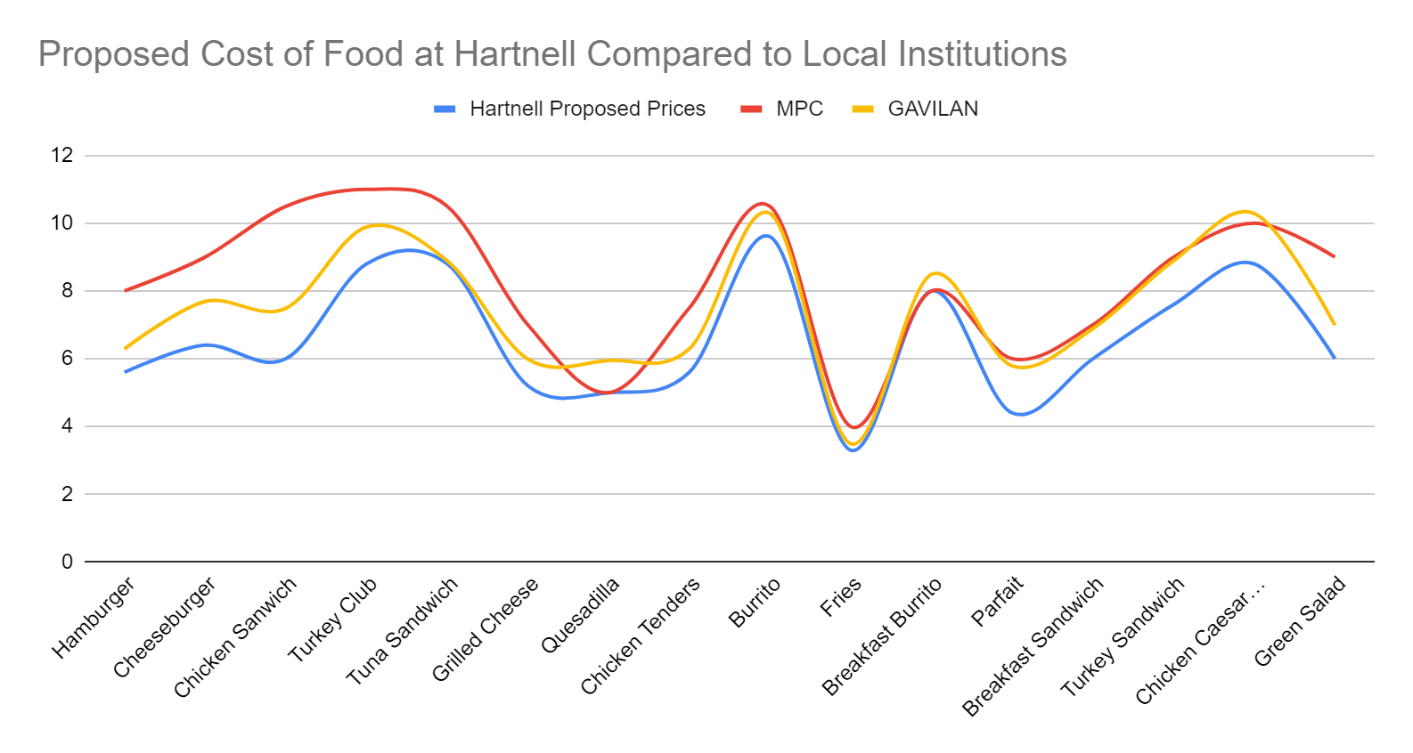
Proposed Cost of Food Increase Compared to Local Institutions

Slide 10
Actual Revenue in Comparison to What Revenue Should be.
Actual Revenue in Comparison to Missed Revenue
9/1/23-10/1/23 Fresh Lunch Sales |  | 52,573.10
If 60% price increase had been applied* |  | 84,116.96
Lost revenue for last month* |  | 31,543.86
*Broad estimation without applying to each item individually
Actual Revenue in Comparison to Missed Revenue
10/2/23-10/16/23 Fresh Lunch Sales |  | 30,016.10
If 60% price increase had been applied* |  | 48,025.76
Lost revenue for last 2 weeks* |  | 18,009.66
*Broad estimation without applying to each item individually

Slide 11
Hours of Operation We’re Able to Provide vs. Contracted out Institutions
 | HARTNELL | MPC | CSUMB (approx. 4k students live on campus) | GAVILAN | CABRILLO
Summer Hours
Mon. | 7:30am-2pm | 9am-1pm | Closed on both of my visits, 11am & 2pm. No hours posted. | 8:30am-1:30pm | 7:30am-3pm
Tues. | 7:30am-2pm | 9am-1pm |  | 8:30am-1:30pm | 7:30am-3pm
Weds. | 7:30am-2pm | 9am-1pm |  | 8:30am-1:30pm | 7:30am-3pm
Thurs. | 7:30am-2pm | 9am-1pm |  | 8:30am-1:30pm | 7:30am-3pm
Fri. | Closed | Closed |  | Closed | Closed
Sat. | Closed | Closed |  | Closed | Closed
Sun. | Closed | Closed |  | Closed | Closed
 | HARTNELL | MPC | CSUMB (approx. 4k students live on campus) | GAVILAN | CABRILLO
Fall Hours
Mon. | 7:30am-7pm | 8am-3pm | (7am)11:00am-8pm | 7:30am-2pm | 7:30am-5pm
Tues. | 7:30am-7pm | 8am-3pm | (7am)11:00am-8pm | 7:30am-2pm | 7:30am-5pm
Weds. | 7:30am-7pm | 8am-3pm | (7am)11:00am-8pm | 7:30am-2pm | 7:30am-5pm
Thurs. | 7:30am-7pm | 8am-3pm | (7am)11:00am-8pm | 7:30am-2pm | 7:30am-5pm
Fri. | 7:30am-2pm | 8am-1pm | (7am)11:00am-8pm | Closed | Closed
Sat. | Closed | Closed | 10am-4pm | Closed | Closed
Sun. | Closed | Closed | 11am-4pm | Closed | Closed

Slide 12
Recommendations/Requests
Implement 1st phase of pricing increases at the beginning of the upcoming Spring term
Complete all pricing increases by the end of FY25 (while basic needs funds are still available)
No changes to most packaged food pricing as its pricing is dictated by the purveyor and has a more sustainable margin.
Increase prices of handmade/fresh food by 50-75% which will still keep us below the pricing at other local institutions. We will roll this out in 3 phases, not all at once.
Increase foot traffic through increased enrollment, advertising, customer satisfaction, and online ordering. (A majority of our handmade food is being sold at a loss. If we simply increase volume without increasing pricing, we will only increase the deficit.)
Increase catering sales.
Operate during hours consistent with class and work scheduling to
provide food service when reasonable.
Continue to provide students with a wide variety of options at the best price possible.
Eventually be able to offer food at a discounted rate to the students.

Slide 13
Questions?

